Slide 1
Internship Presentation
Promact Infotech Pvt ltd
Submitted to : Ruchi Patel Ma’am
Submitted By : Shubhi Miradwal(EN16CS301259)

Slide 2
About Promact Infotech Pvt Ltd
Promact is a core IT company with 16 years of experience
Till date company has delivered near about 700+ software to the clients having 500+ clients worldwide
Provide services in the below fields
Product Engineering
Mobile development
DevOps
Artificial Intelligence
Blockchain Technology

Slide 3
Tools and Technologies Learned:
Tools:
GIT
Framework:
ANGULAR
ASP.NET
Language:
TYPESCRIPT
JAVASCRIPT
C#
Agile Software Development Methodologies:
SCRUM FUNDAMENTAL
SOFTWARE TESTING

Slide 4
Project- I Leave Management System

Slide 5
Introduction
Leave Management is one of the simplest yet crucial HR activities that often consumes a significant portion of the HR team’s time.
Manual Leave Management is very tedious task as I require excessive paper work, Legal Compliance, as very leave tracking.
Automating the leave management process can help facilitate a hassle free and more positive employee-employer work relationship, while also ensuring business productivity is not compromised.

Slide 6
What the project does?
It basically automate the manual Leave Management System
Employee can apply for new leaves, track there previously applied leaves , edit their profile and the applied leaves can be rejected or approved by the admin
Admin can add, update and delete employee
Admin can create type of leaves, for example Casual Leave, Sick Leave and Restricted Leave etc. Each leave type must have a name and there will be a maximum number of days allowed per leave type. For example, if maximum number of days allowed for Casual Leave is 14 days then any employee cannot avail more than 14 casual leaves in a year.

Slide 7
Tools and Technologies Used
Front End : Angular
Back End: ASP.NET
Database: Microsoft entity framework
Code Editor: Visual Studio

Slide 8
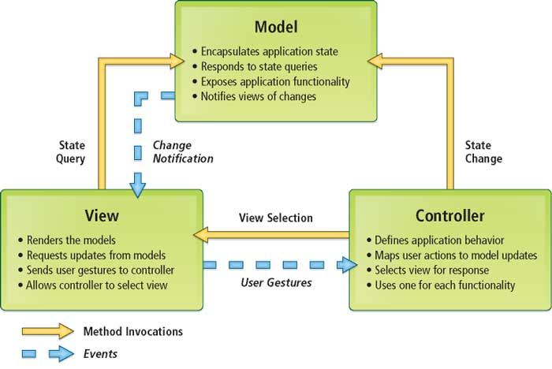
What the project does?

Slide 9
Angular
Angular is a JavaScript framework written in a language called typescript (a compiled, typed and super language of JavaScript), used to create user interfaces or frontend apps
Advantages of Angular:
Component Based Architecture
Command Line Interface
MVC Architecture Implementation
Services and Dependency Injection

Slide 10
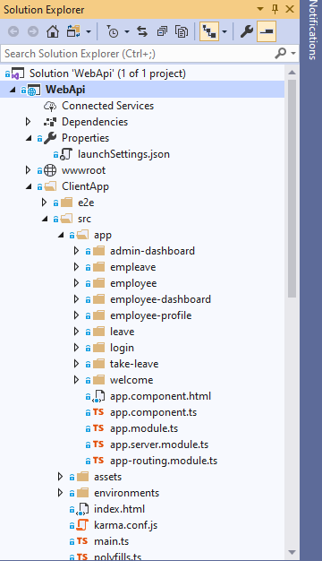
Components:
Admin-Dashboard
Empleave
Employee
Employee-Dashboard
Employee-Profile
Leave
Login
Take-leave
Welcome

Slide 11

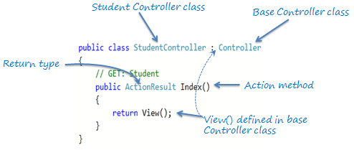
Controllers:
The Controller in MVC architecture handles any incoming URL request. Controller is a class, derived from the base class System.Web.Mvc.Controller. Controller class contains public methods called Action methods. Controller and its action method handles incoming browser requests, retrieves necessary model data and returns appropriate responses.

Slide 12
What is Microsoft Entity Framework
Entity Framework was first released in 2008, Microsoft's primary means of interacting between .NET applications and relational databases. Entity Framework (EF) is an object-relational mapper that enables .NET developers to work with relational data using domain-specific objects. It eliminates the need for most of the data-access code that developers usually need to write. The Entity Framework provides three approaches to create an entity model
Code First
Database First
Model First

Slide 13
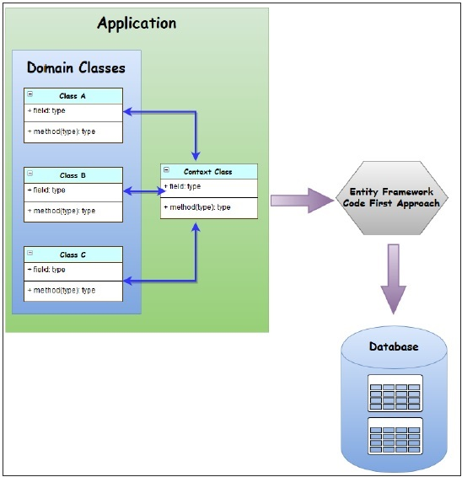
Working of Microsoft Entity Framework(Code First Approach)

Slide 14
Database
Table1: Employee:
1. Id
2. Name
3. DOB
4. DOJ
5. Salary
Table 2: Emp Leave:
1. Id
2. Name
3. MaximumLeavesAllowed
Table 3:EmployeeLeaveMapping:
1. Id
2. EmployeeId
3. LeaveId
4. LeaveStartDate
5. LeaveEndDate
6. Status.

Slide 15
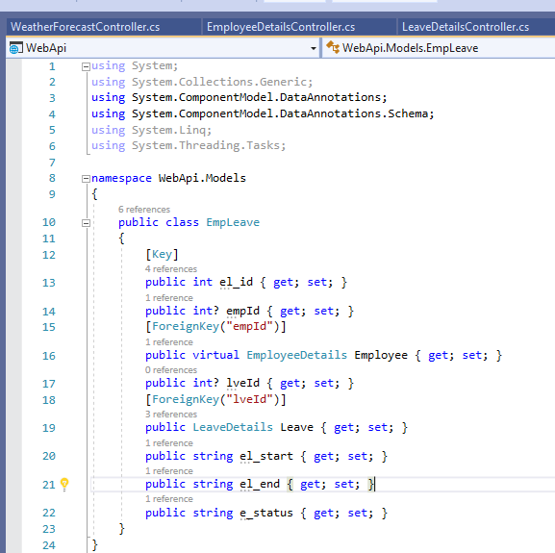
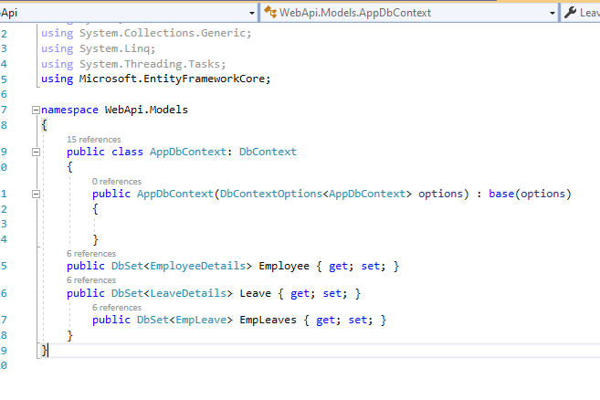
Model/Domain Class
Context Class

Slide 16
LAYOUT OF THE PAGES

Slide 17
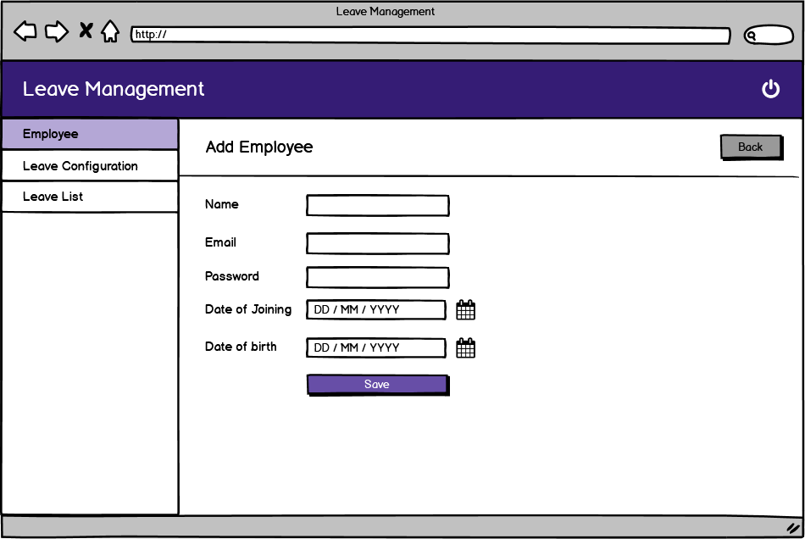
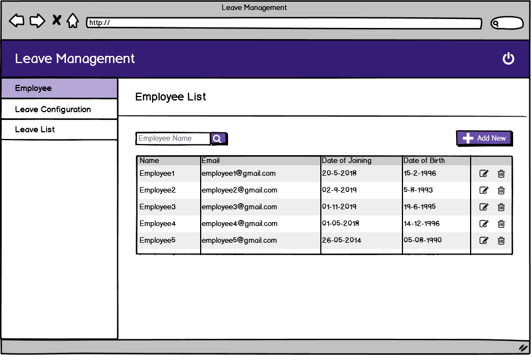
ADD EMPLOYEE
EMPLOYEE LIST

Slide 18
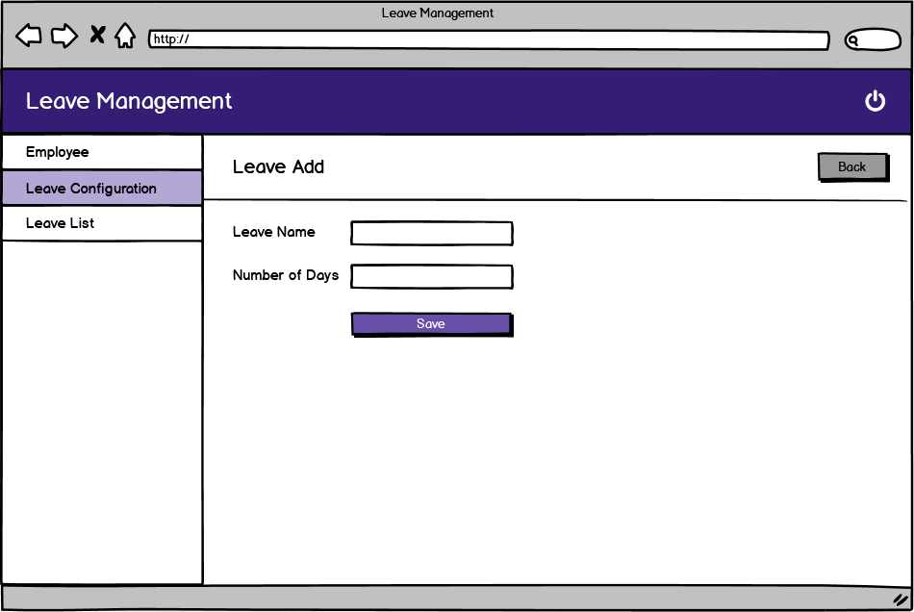
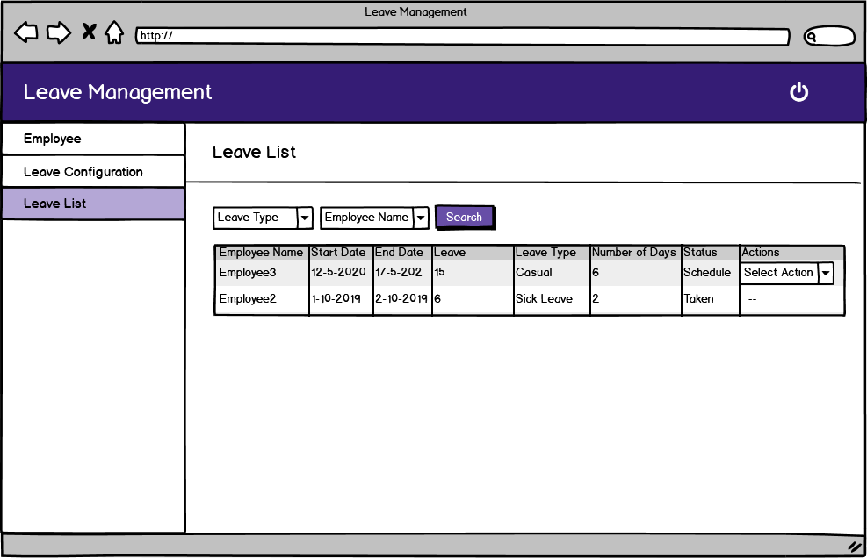
LEAVE ADD
LEAVE LIST

Slide 19
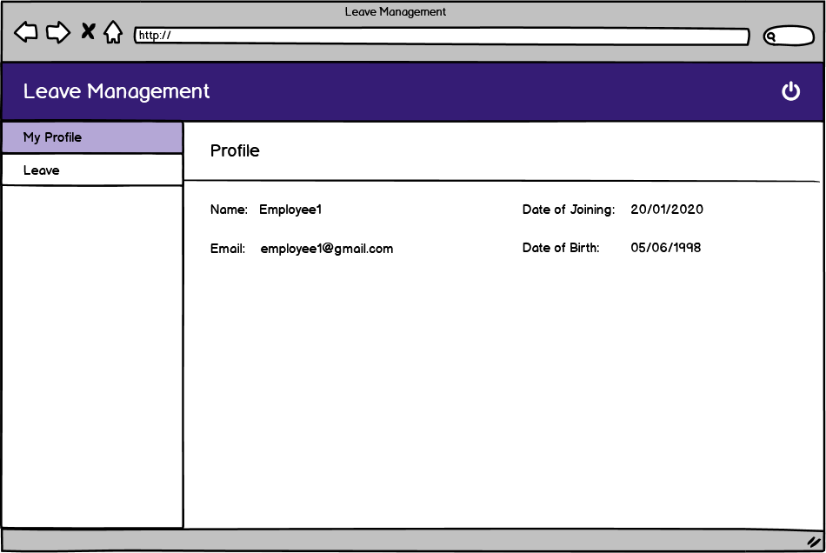
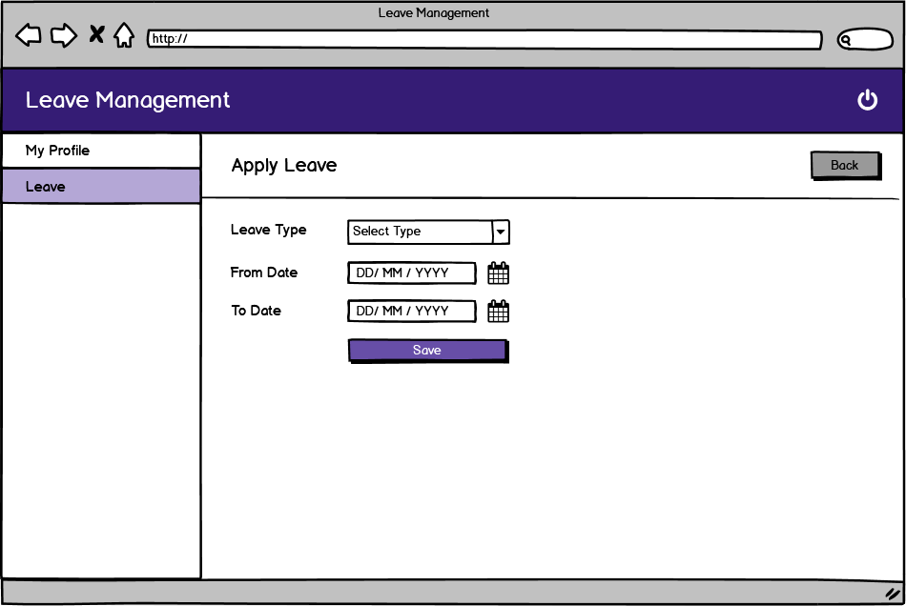
MY PROFILE
APPLY LEAVE

Slide 20
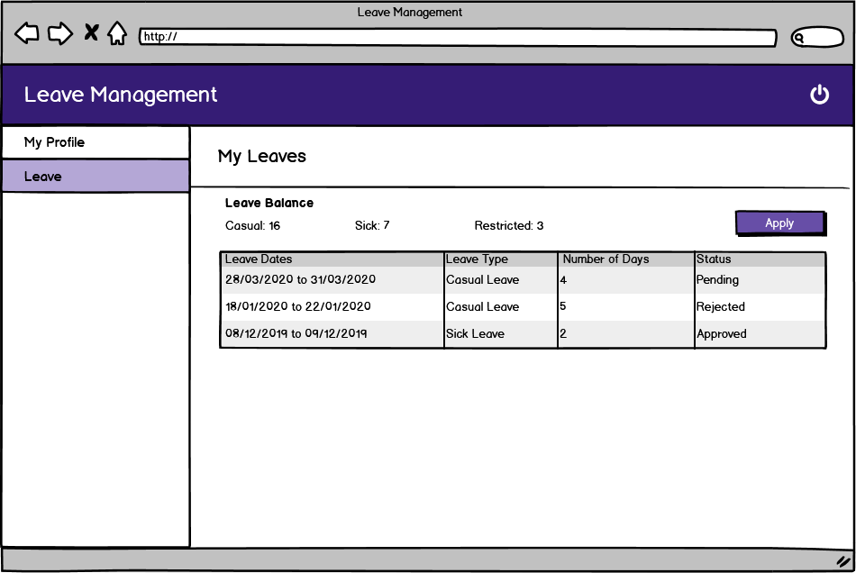
MY LEAVES

Slide 21
Project – II Covid-19 Dashboard

Slide 22
Overview
The objective of this project is to develop a dashboard which give live tracking of the infectious Coronavirus Disease.
It gives state wise update of the cases and well as overall status of the country.
It shows Graphical representation of the monthly increase in the number of cases in country.

Slide 23
Tools and Technologies Used
Code Editor: Sublime text
Framework: Angular

Slide 24
ANGULAR MODULES USED
HttpClientModule
HTTP Client helps us to fetch external data, post to it, etc. We need to import the http module to make use of the http service.
NgxChartsModule
NGX-Chart is a charting framework for Angular which wraps JavaScript library and uses Angular to render and animate SVG elements. This module helps to make UI more interactive and it is one of the most popular frameworks for Angular application
AppRoutingModule
The router module is imported from @angular/router and is used for routing RouterLink, forRoot, and forChild.

Slide 25
RXJS Library
RXJS (Reactive Extensions for JavaScript) is a library for reactive programming using observables that makes it easier to compose asynchronous or call-back-based code
Browser Module
The browser module is imported from @angular/platform-browser and it is used when you want to run your application in a browser.

Slide 26
Created Graphs using the data and Angular NGXChartModule
Created Desired UI using Angular NGXCharstModule representing data
Fetching data by hitting an API
Convert Data in Object
Created Pie charts showing the affected regions using the data and Angular NGXChartModule

Slide 27


